Slide 1
FY22 Deep Dive Kickoff

Slide 2



Healthy Tension between Business Unit Roadmap and Enterprise Target State
There will be a natural point of “healthy tension” between the CIO / Business Unit’s near term roadmap and the Enterprise Target State
How do we manage that healthy tension?
Enterprise Target State
Common Enterprise Processes
Built with Common Enterprise Capabilities
Leveraging Enterprise Technology Standards
CIO Roadmap
CIO Roadmap
Tension to be
Managed
CIO Roadmap
CIOs Roadmaps will be a balance of business priorities, app rationalization, digital opportunities, etc..
We must expect these roadmaps to have varying starting points, varying economic cases, varying funding levels, varying velocities, and varying constraints.
However, we also have a goal to standardize so that we can reuse processes, capabilities, and technology where doing so adds significant value across business units.

Slide 3
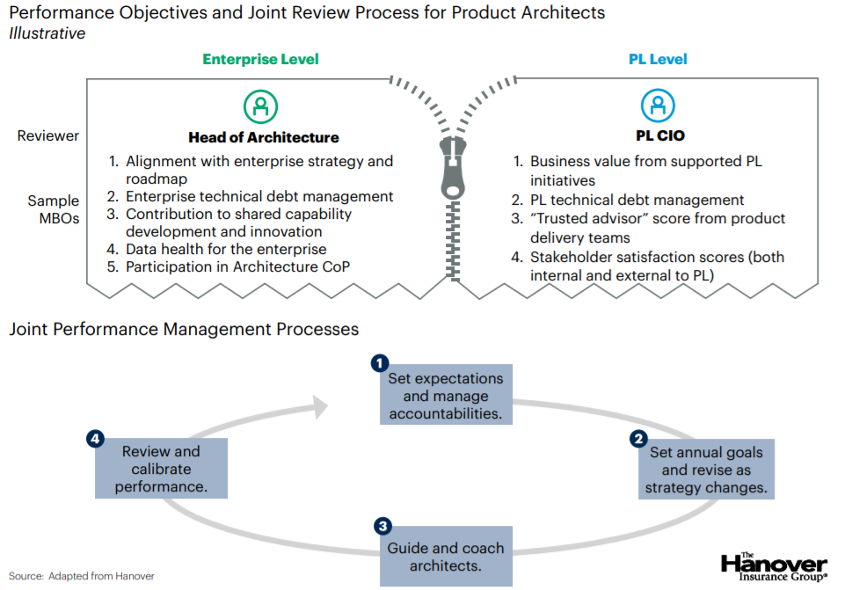
Manage the Health Tension through Partnership
Enabled through IT Strategy and Planning Office
Strategic Planning will be the vehicle to seek critical dependencies, synergies, economies of scale, and portfolio balancing opportunities across Business Units.
ITGC(*) will be the forum to finalize the “handshake” resolution of healthy tension for significant programs, enabled by Enterprise Architecture.
(*) ITGC details, membership, processes TBD

Slide 4
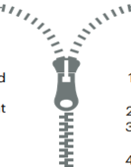
The Federated Model Feedback Loop: Business Unit and Enterprise
The core EA team (EA CoE) must own the strategy, standards and governance across the federated Enterprise Architecture capabilities in order to mature the capabilities, manage cross-domain opportunities, defragment and rationalize the application and technical landscapes, reduce technical debt, and promote re-use.
Business Unit CIO Team
Programs
Digital
Business Unit CIO Team
Programs
Business Unit CIO Team
Programs
Project
Project
Project
Project
Project
App Rat
Project
Project
Project
Digital
Project
Project
App Rat
Project
Project
Project
Project
Digital
Project
App Rat
Project
Project
Project
Project
Project
EA CoE
Portfolio Arch
Global TDA
Business Arch
Digital
Platform Arch
Infrastructure Arch
Security Arch
Technology Arch
Information Arch
Business Unit Roadmap
Seeking risks, synergies, dependencies
Domain Arch(s)
Solution Arch(s)
Domain Arch(s)
Solution Arch(s)
Domain Arch(s)
Solution Arch(s)
Best practices, common ways of working
Enabling Strategies
Resolution of Healthy Tension
Risk
Synergy
Dependency

Slide 5
What we need to do ASAP as an enabler for FY22
We have an urgent need to comb the FY22 demand across all business units to identify the significant risks, synergies, and dependencies.
We will have a deep dive per domain to review the domain roadmap as well as the immediate FY22 demand.
Some business units are more mature than others. We are looking to assess the best possible view you currently have.
At the deep dive, each Domain Architect will present two views:
The Domain or Sub-Domain (major program) roadmap view
This is your roadmap, your hypothesis for how the portfolio matures over time.
If possible, leverage the emerging template standard found here. However, if you have an different roadmap format the conveys similar information, then leverage what you have for this exercise.
The Domain FY22 Demand Summary
You are required to use the format found here.
The FY22 Demand Summary is an outline of the expected FY22 Solution Visions and Solution Designs.
This is an outline, not a vehicle for solutioning.

